Slide 1
Service Management and System Configuration Files in Linux

Slide 2
Service Management in Linux
Service management in Linux refers to the process of managing the lifecycle (starting, stopping, restarting, enabling, disabling, and checking the status) of system services (also known as daemons). These services run in the background to perform various tasks like handling network requests, logging, and providing security.

Slide 3
Type of Service Manager
Init: The older service manager system, replaced by systemd in many distributions, but still in use on older systems. It manages services using scripts located in /etc/init.d/.
Commands:
service <service> start or service <service> stop are used here.
Systemd: The most widely used service manager in modern Linux distributions. It manages services, starts them at boot, and allows users to control them during runtime. It manages services located in /lib/systemd/system/ or /etc/systemd/system/ .

Slide 4
How service management happens from booting…
Power On: BIOS/UEFI Initialization When machine is power on, BIOS/UEFI initializes hardware components, performs POST. And looks for a bootable device.
Boot Loader: After BIOS/UEFI hands control to the bootloader GRUB and bootloader locates and load kernel into RAM Memory.
grub config - /boot/grub2/grub.cfg. Kernel file - /boot/….
Kernel Initialization: Kernel takes control of system and setup hardware component, mount root file system and initialize kernel-level services and drivers. And hands over control to systemd (or the init system).

Slide 5
How service management happens from booting…
Systemd Initialization: Now systemd takes over and responsible for managing the booting process, It is the first process started by the kernel (PID 1).
Systemd Unit Files: Units in systemd are defined as files with different types (e.g., service, socket, mount, target). They are located in /lib/systemd/system/ or /etc/systemd/system/.
Now Targets are used to group units together to achieve specific system states.

Slide 6
How service management happens from booting…
Default Target: Now systemd looks for default target to boot system into. This target is typically either multi-user.target (for systems without a GUI) or graphical.target (for systems with a GUI).
You can check : Systemctl get-default && Systemctl set-default graphical.target
Start Dependencies: Once the target is identified, systemd loads all unit files (services, sockets, etc.) that are dependencies of the target. For example, graphical.target depends on multi-user.target, network.target, and display-manager.service for the GUI.

Slide 7
How service management happens from booting…
Services are started in parallel but systemd ensures that service dependencies resolve first. Eg. network.target ensures networking up before sshd.service is start for SSH.
Service Management: During boot, systemd starts services according to their unit files and dependencies.
For Example - network.service initializes networking
cron.service starts the cron job scheduler.
getty@.service starts the login prompts on different terminals.

Slide 8
How service management happens from booting…
Complete system boot: After all services required by the default target (like graphical.target) are started, the system is fully operational.
Which includes starting display manager like(gdm.services or lightdm.services) which then presents a graphical login screen.
Example: Can switch between targets
Switch to multi-user mode (console-based): systemctl isolate multi-user.target
Switch to graphical mode: systemctl isolate graphical.target

Slide 9
What is systemd.
Systemd is a system and service manager for Linux operating systems. It is used to boot the system and manage its processes.
It provides a range of features for managing services, logging, and network configurations in Linux.
Systemctl are used to interact with systemd and manage these services.
Services in systemd are defined by unit files. These files describe how services should be started and controlled.
There are different types of unit files, including .service, .socket, .mount, and .target units.
Example - Service Unit (.service) – Manages system services (daemons like apache2, ssh)
Example - /lib/systemd/system/ssh.service
Targets are similar to runlevels in older init systems. They group services and tasks that should be started or stopped together.

Slide 10
Systemctl - Command line utility
Systemctl is command-line tool for managing system services in Linux systems, especially those using systemd.
Syntax:
systemctl [command] [service name]
[command] = The action we want to perform (start, stop, enable, disable, etc.)
[service] = The name of the service we want to perform the action on.

Slide 11
How to manage system services…
Starting Services
Syntax: systemctl start [service name]
Example:
If we want to start our SSH service.
systemctl start sshd
Stopping Services
Syntax: systemctl stop [service name]
Example:
If we want to stop our SSH service.
systemctl stop sshd

Slide 12
Enabling and Disabling Services:
Enabling Services
If we want to enable our firewall service:
systemctl enable firewalld
Disabling Services
If we want to disable our firewall service:
systemctl disable firewalld
Viewing Status of Services
If we want to see the status of our firewall service.
systemctl status firewalld

Slide 13
Restart and Reloading Services:
Restarting Services: Stop the service apply the changes and then restart service.
If we want to restart our Apache service.
systemctl restart httpd
Reloading Services: Apply the changes without stopping service.
If we want to reload our Apache service.
systemctl reload httpd

Slide 14
Masking and Unmasking Services:
1) Masking a service prevents it from being started or enabled, even if it is required by other services.
If we want to mask our MySQL service.
systemctl mask mysqld
2) Unmasking a service allows it to be started or enabled again.
If we want to unmask our MySQL service.
systemctl unmask mysqld

Slide 15
Runlevels and Targets
Linux systems have historically used runlevels to define different states of system operation. With the adoption of systemd, runlevels were replaced by targets.
Changing the Default Target
Syntax: systemctl set-default [target]
Example:
If we want to change the default target to graphical.target (which will start the graphical user interface).
systemctl set-default graphical.target
This default target determines which system services are started when the system boots up.

Slide 16
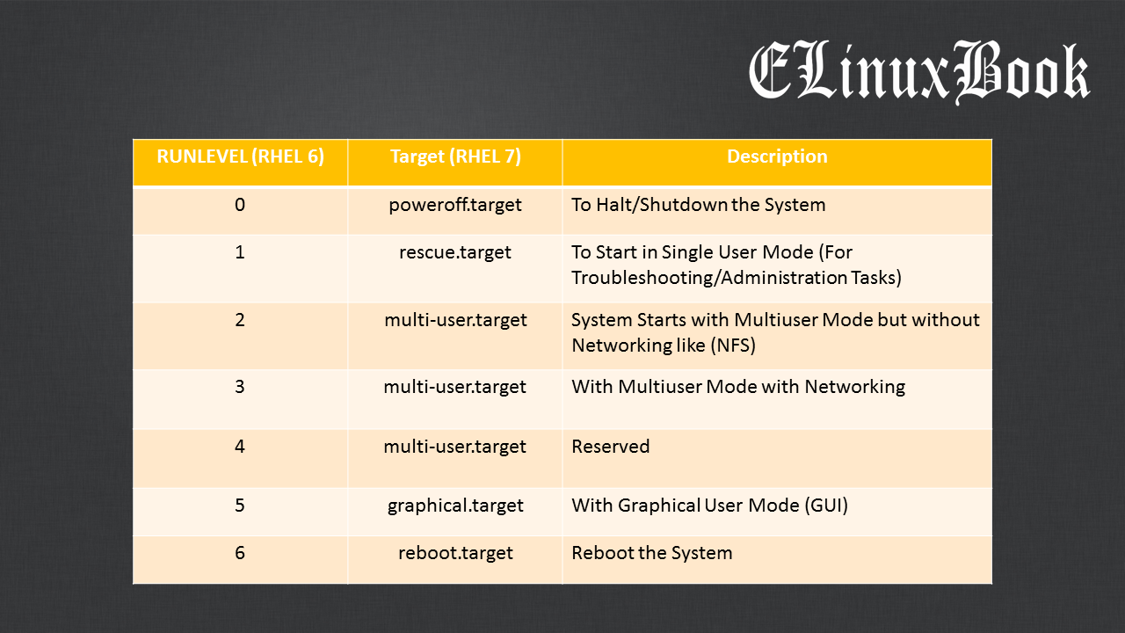

Slide 17
Attribute available in systemctl command in
–version
This option displays the version number of the systemctl command.
Syntax: systemctl –version
–help
This option displays the help manual for systemctl, including a list of available options and commands.
Syntax: systemctl –help
–type
The argument in this case should be comma-separated list of unit types such as service and socket.
Syntax: systemctl --type=service

Slide 18
Attribute available in `systemctl` command
–force
This option forces the service to start or stop, even if it has dependencies that are not yet started or stopped.
Syntax: systemctl stop --force httpd.service
–quiet
This option is used to suppress the printing of results of various commands and the hints about the truncated lines.
For example: to reload the systemctl daemon without showing any output.
Syntax: systemctl daemon-reload –quiet

Slide 19
System configuration files
Configuration files are essential for configuring and customizing various aspects of a Linux system.
Controls how a program, utility, or process works.
They are plain text files that store settings and parameters for software applications, system services, and user preferences.
Many configuration files are located in the /etc directory, which serves as a central repository for system-wide settings.
Other configuration files are located in specific directories, such as /home, for user-specific settings.

Slide 20
System configuration files in Linux
System-Wide Configuration Files
User-Specific Configuration Files
Application Configuration Files
Service Configuration Files

Slide 21
System configuration files in Linux
System-Wide Configuration Files:
Files which is primarily located in “ / “, and required superuser privileges to modify it.
Example:
/etc/passwd: This file contains information about the users on the system, including their username, user ID, group ID, home directory, and shell. This file is readable by all users on the system, but it is important to keep it secure to prevent unauthorized access to user accounts.

Slide 22
System configuration files in Linux
/etc/shadow: File contains the encrypted password and other security information for each user on the system. And this file is only readable by the root user and is therefore much more secure. It is used to store information such as the last password change, minimum password age, and maximum password age.
/etc/group: File lists the groups on the system and their members. It contains information about each group, including its name, group ID, and a list of users who are members of that group. This file is used to manage user and group permissions for accessing files and directories on the system.

Slide 23
System configuration files in Linux
/etc/fstab: File is used to control the way file systems are mounted at boot time and during the normal operation of the system. It lists all available file systems and their mount points, including options and dump frequencies.
/etc/sudoers: File is used to manage the sudo command, which allows users to run commands as the root user.
/etc/hosts: File is used to map hostnames to IP addresses. It is a simple text file that can be used to specify custom hostnames and IP addresses, bypassing the need to use a DNS server.

Slide 24
System configuration files in Linux
/etc/hostname: File is used to contain system’s hostname
/etc/resolve.conf: File is used to configure the system’s DNS resolver. It contains information about the DNS servers that the system should use for name resolution, as well as search domains and options. This file is crucial for proper network communication on a Linux system.
/etc/network/interfaces: File is used to configure network interfaces on a Linux system. It contains information about the network interfaces, such as IP addresses, netmasks, and gateways, as well as options for configuring DHCP and static IP addresses.

Slide 25
System configuration files in Linux
User-Specific Configuration files: User-specific settings are stored in the user's home directory, typically in hidden files “ . ”
This control user preferences and environment settings.
~/.bashrc: Shell-specific configuration for each user, defining aliases, environment variables, and functions.
~/.profile or ~/.bash_profile: Executes commands at login to set environment variables.
~/.vimrc: Vim editor configuration for user-specific preferences.

Slide 26
System configuration files in Linux
Application Configuration Files: These control the application's internal settings and features. This Files manage how the application itself behaves, such as server settings, options, and customizations for the application’s functionality.
/etc/apache2/apache2.conf - Apache web server configuration.
/etc/nginx/nginx.conf - NGINX web server configuration
/etc/samba/smb.conf - Samba configuration for file sharing.
Example: If apache2 is running, so which file will be hosted, that files directory path, port number on which port is listening, this thing managed by application configuration files.

Slide 27
System configuration files in Linux
Service Configuration Files: Files manage how the service for that application is started, stopped, or managed by the system (usually via systemd or another init system). These files are related to how the system handles the application's lifecycle as a service (e.g., auto-start on boot, service restarts).
Located in /lib/systemd/system/ or /etc/systemd/system/ for systemd-managed services.
/lib/systemd/system/apache2.service
/lib/systemd/system/mysql.service
/lib/systemd/system/nginx.service
Systemd always gives priority to files in /etc/systemd/system/, which means any changes made there will override the defaults from /lib/systemd/system/.

